Slide 1
Digital Future
Silvija Seres

Slide 2
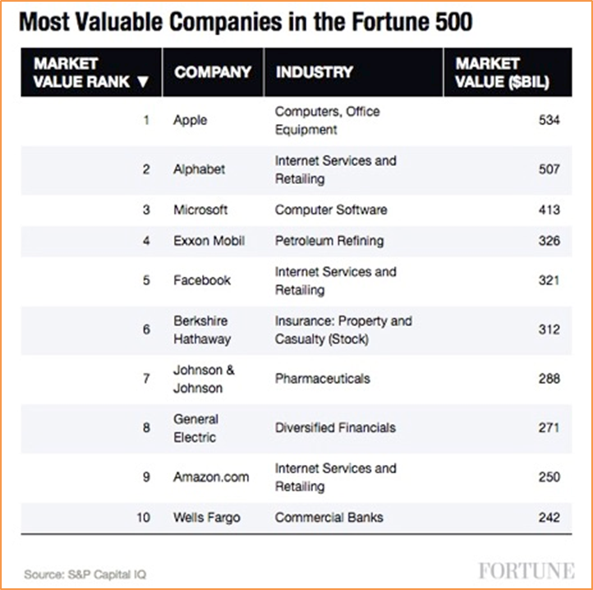
Tech rules the world. Software eats it.

Slide 3
The greatest disruption ever
This time is different:
Exponential
Polarising
Combinatorial

Slide 4
Exponential
Deceptive at first.

Slide 5
Polarising
Winner takes all.

Slide 6
Combinatorial
There are TWO sweet spots:
Digital marketplaces
Enabling technologies

Slide 7
12 Gutenberg moments at once
AI, big data
Robotics, automation
Biotech, bioinformatics, synthetic biology
Energy, smart cities and smart houses
3D printing, nanotech
Networks, sensors
Digital medicine
Fintech, regtech, edtech
VR and AR
Genetics
Transport and drones
Blockchain

Slide 8
3 strategic buckets: efficiency business transformation social transformation

Slide 9
Nordea: Building efficiency with new core banking platform.

Slide 10
Schibsted: Cannibalization as a survival tool, through finn.no and SCM.

Slide 11
NRK: New production and distribution for democracy.

Slide 12
Social effects of digitalization
Polarisation
Algorithmisation
Globalisation

Slide 13
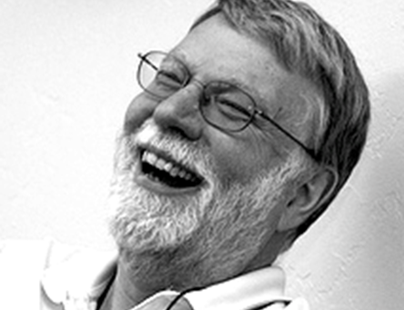
John Seely Brown
Halftime of a skill is down to 5 years.

Slide 14
Borregård: Lifelong learning in practice, now, for all.

Slide 15
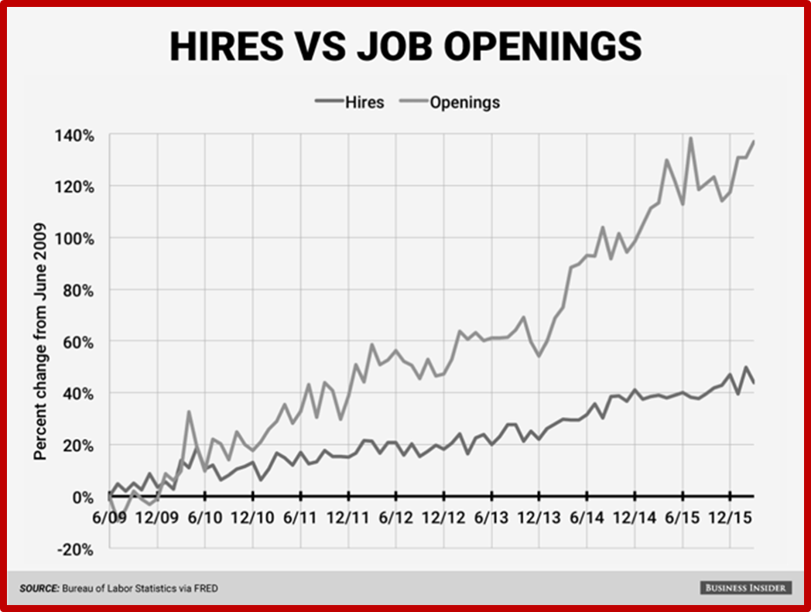
DOL gap
The growing skills gap!

Slide 16
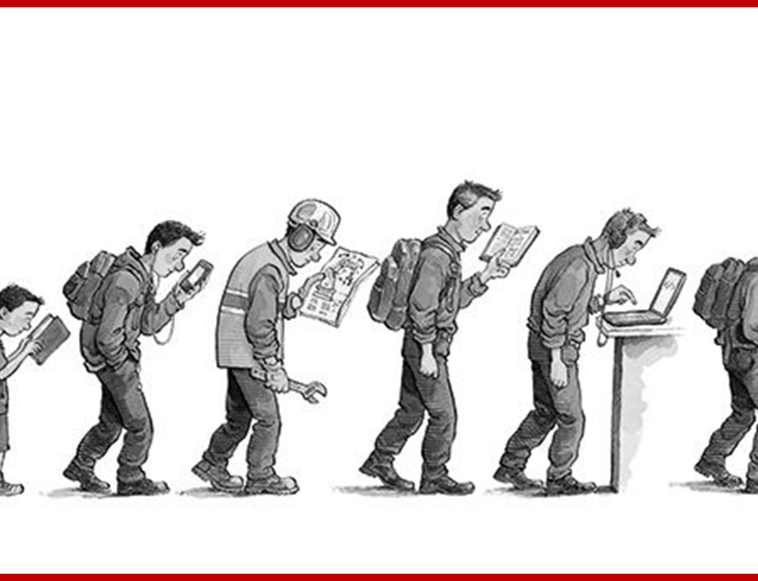
Economist & Lifelong Learning
When education fails to keep pace with technology, the result is inequality.

Slide 17
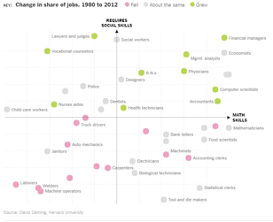
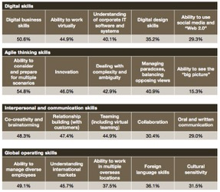
Future skillsets

Slide 18
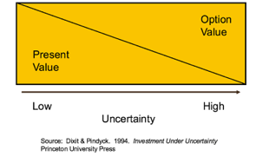
Bi-dexterous leadership and risk taking!

Slide 19
Hedgehog and the fox:
Hedgehog knows one big thing.
Fox knows many small.
BE A BIT OF BOTH!

Slide 20
Some reading ideas

Slide 21
Thank you, and good luck!
Questions: silvija.seres@gmail.com
Just fun: @silvijaseres
LØRN.TECH
@silvijaseres

